Slide 1
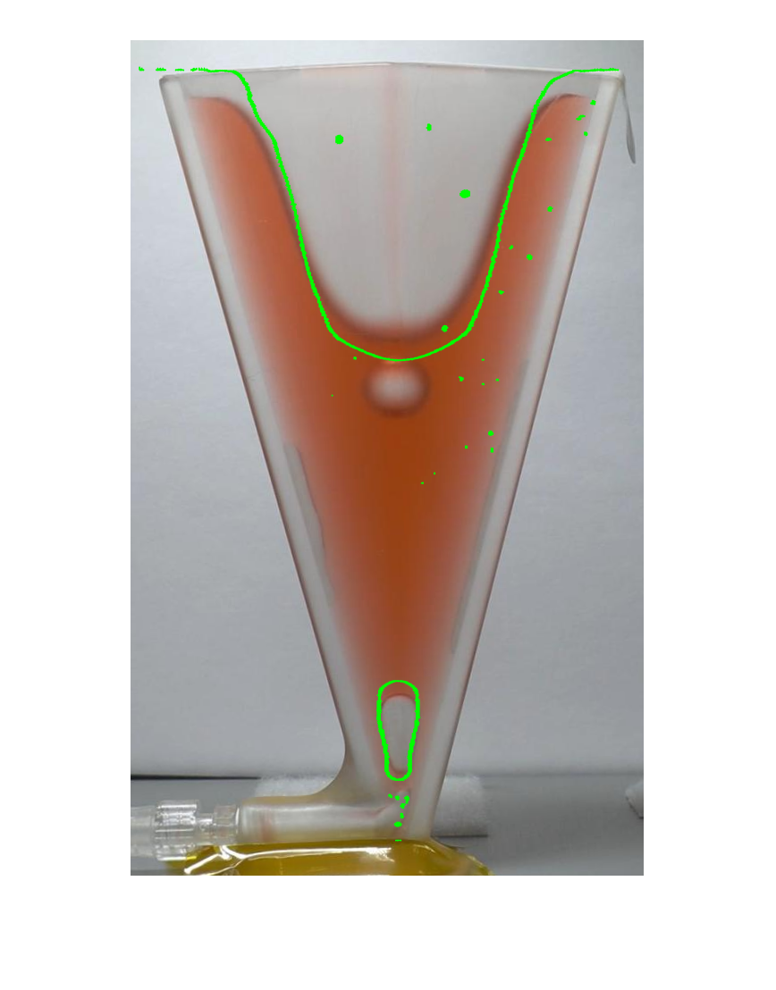
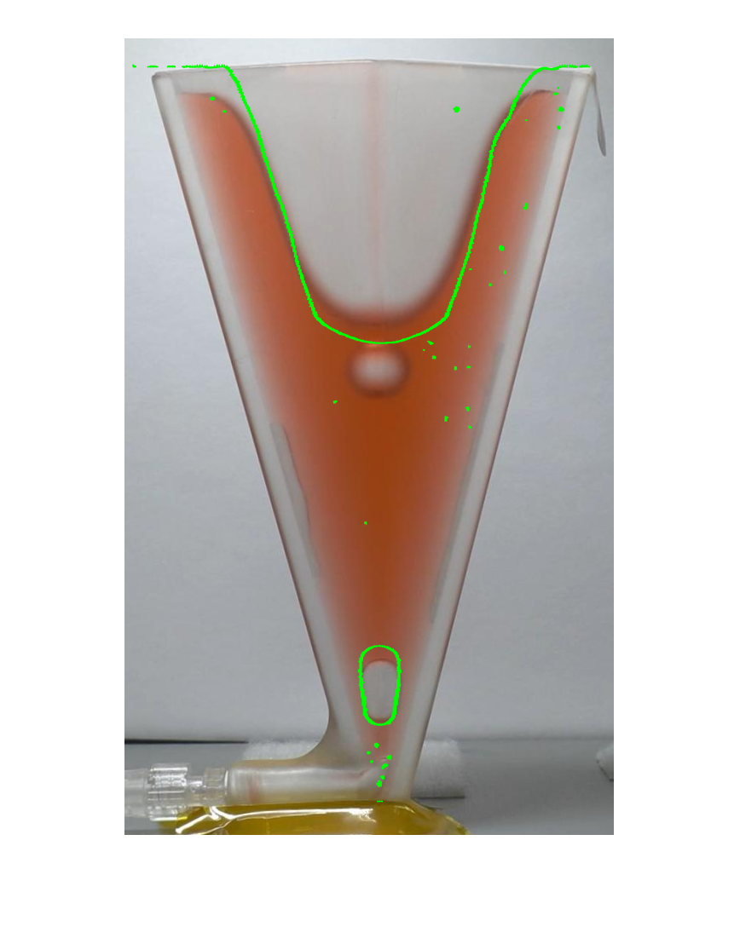
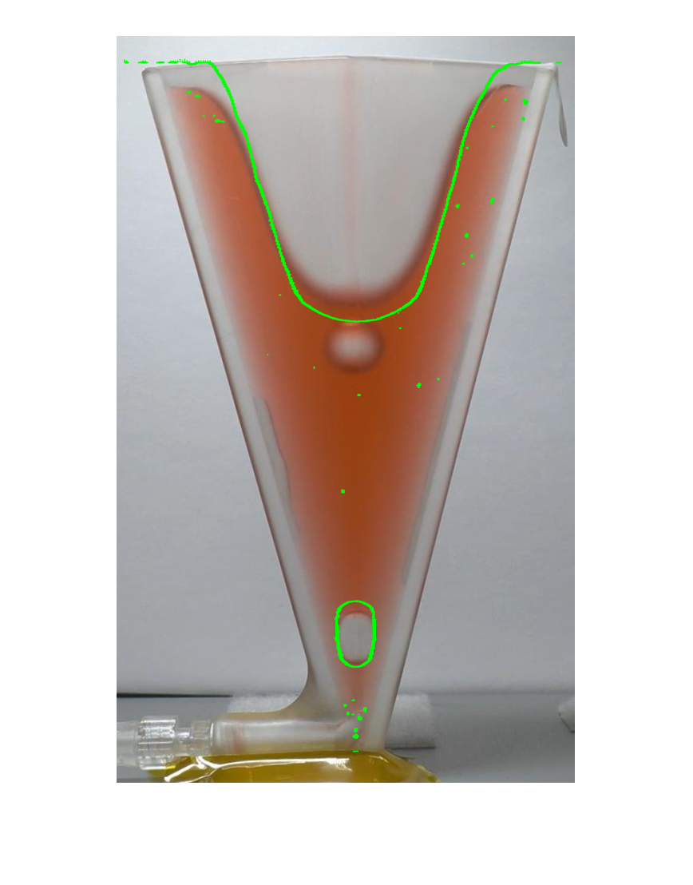






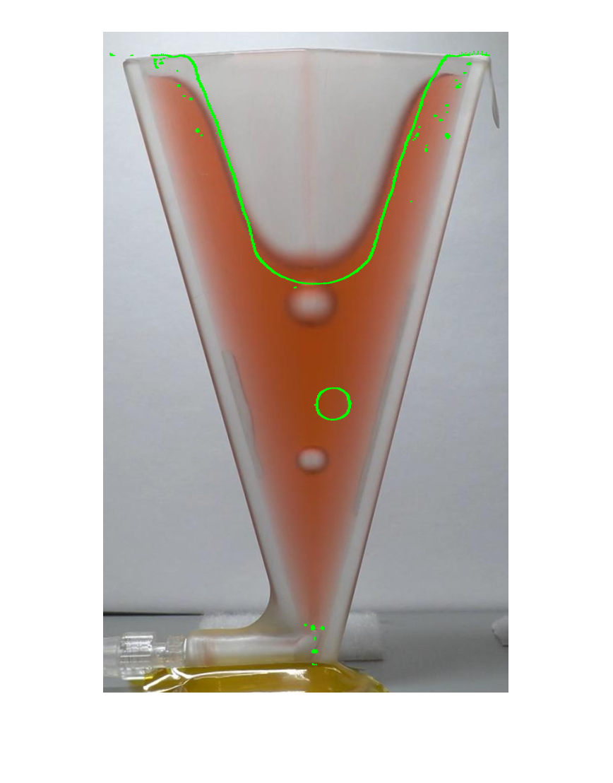
ISS 9-mil 1x Experiment Speed [real time [sec]-frame] video is 60 fps
[0-0] [0.1-6] [0.2-12] [0.3-18] [0.6-36]
[0.9-54] [1.2-72] [1.5-90] [1.8-108] [3.2-192]

Slide 2






ISS 9-mil 2/3x Experiment Speed [sim time [sec]-Exp. Time [sec]] video is 60 fps
[0-0] [0.3-0.2] [0.6-0.4] [0.9-0.6] [1.2-0.8]
[1.5-1] [1.8-1.2]

Slide 3




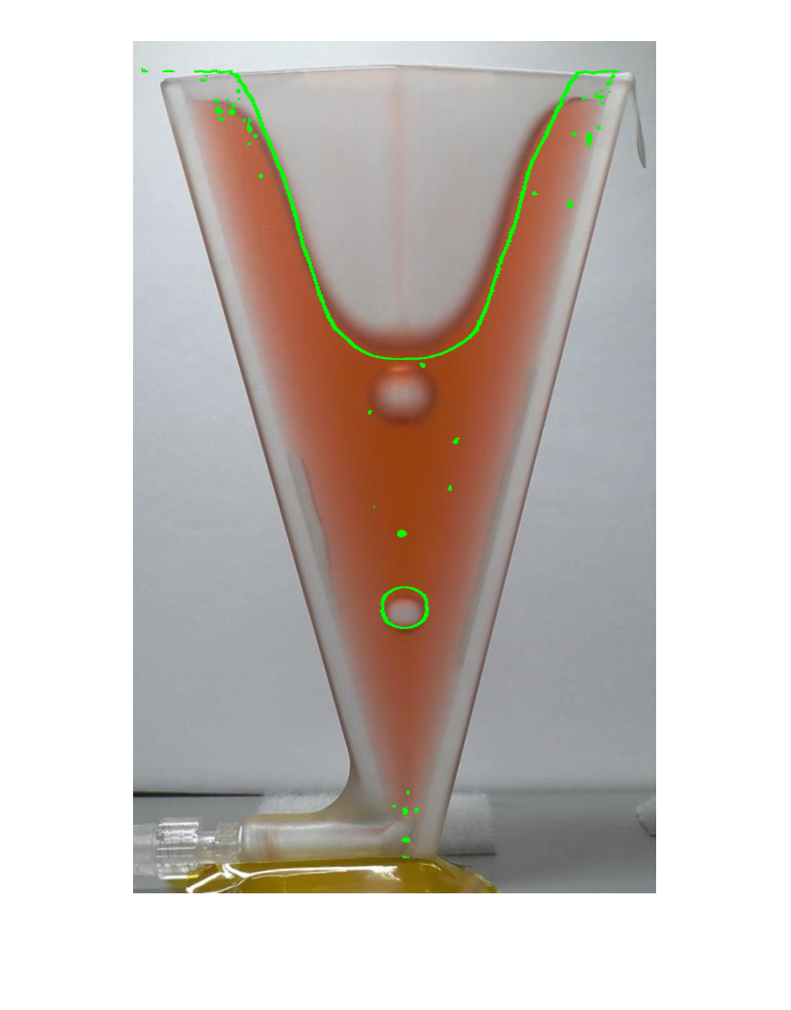
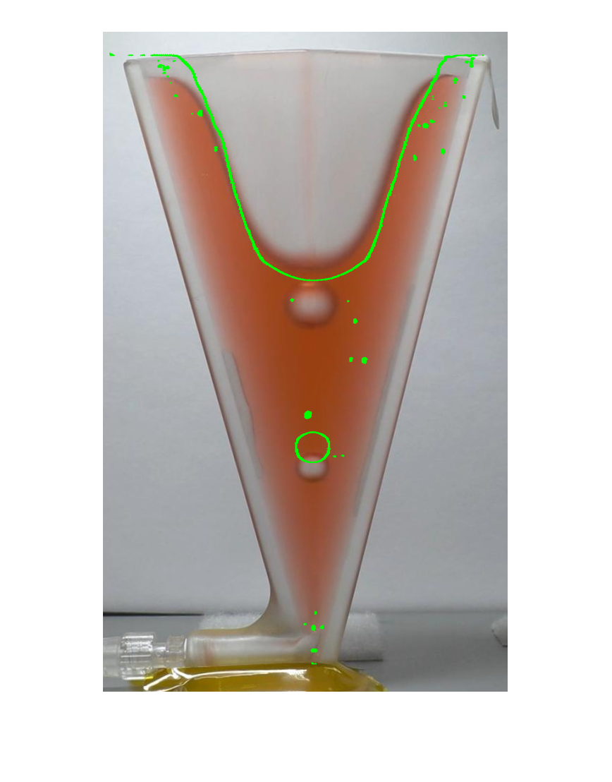
ISS 9-mil 4/3x Experiment Speed [real time [sec]-Exp. Time [sec]] video is 60 fps
[0-0] [0.3-0.4] [0.6-0.8] [0.9-1.2] [1.2-1.6]
[1.5-2.0] [1.8-2.4]

